Slide 1
Productivity through AI
Kevin Redmond
Vice President
Technology
Northern, Central & Eastern Europe
May 15, 2024

Slide 2









Clients
Strategic Model
Financial Model
Clients
Investors
Client value creation, market selection, differentiation, technology
Management system, incentives, measurements, revenue, cash
With two leading platforms...
Sustainable Revenue Growth...
watsonx
Fueled by Technology & Consulting leveraging the integrated value of IBM to bring new value to clients
The industry’s leading hybrid cloud platform
The AI and data platform built for business
…a comprehensive suite of business…
…productivity...
  Consulting: Digital transformation partner of choice with hybrid cloud & AI
  Software: Platforms and solutions to build, deliver, and run trusted AI & open hybrid cloud
  Infrastructure: Transaction-processing, compute, storage, and cloud platform for mission-critical workloads
  Digital transformation: Reimagine internal processes, workflows and be client zero for our technology
  Investments: Aligned to our platforms and strategy and accelerate outcomes
The catalyst that makes the world work better
…and a global ecosystem of partners
…and cash generation...
Distributors & resellers | ISVs & MSPs | System integrators
Cash is the fuel for our strategy and our financial model
| Hyperscalers | Developers

Slide 3
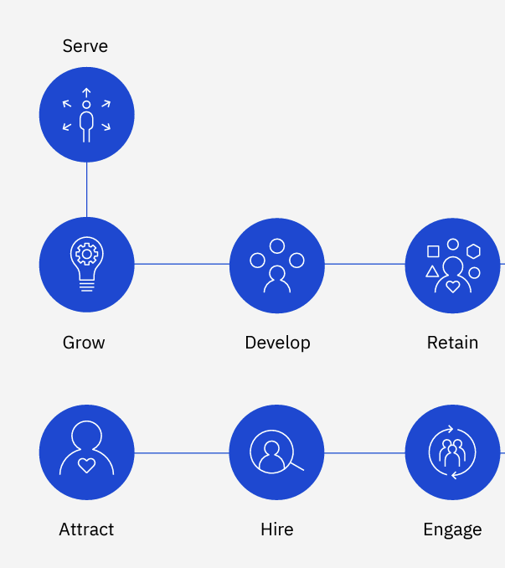
HR Productivity Example
Productivity is not simply about cost saving
Productivity is about doing MORE with existing
  Faster response time
  Intelligence on recruitment
  Intelligence at manager fingertips on retention, pay, promotion, career
  Individual level learning plans, quick answers
HR teams to support more queries focus on higher skill projects bringing increased value to business

Slide 4

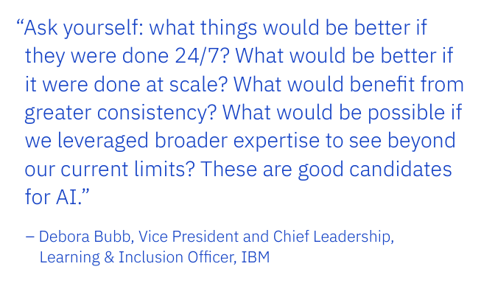
Where next ?

